Slide 1
MBAN 6400 S8 – Factor Analysis (FA) Hemant Sangwan

Slide 2
Agenda – Factor Analysis (FA)
Fundamentals of Factor Analysis (FA)
What is FA?
Importance of FA, with examples and applications
Algorithms for FA

Slide 3
Factor Analysis
Can we explain the performance of a player based on underlying (unobserved) structure in data on health and game statistics?
What are underlying (unobserved) traits which can drive and explain your inclination toward one type of hobbies over other types? For example, reading, meditation, listening music vs socializing with friends, etc.
Historically, FA was developed to explain students’ intelligence & their performance in different courses

Slide 4
Factor Analysis – Terminology
A student’s score in a course depends on intelligence and inclination (or aptitude), which is specific to the subject. For example, for 6 courses – mathematics, physics, chemistry, history, arts, and language
g_{subject}=f(Intelligence) + w_{subject}
g_{m}=0.75 I + w_{m} g_{p}=0.55 I + w_{p} g_{c}=0.60 I + w_{c}
g_{h}=0.80 I + w_{h} g_{a}=0.25 I + w_{a} g_{l}=0.50 I + w_{l}
Terminology in FA
Score in a course gsubject is an indicator of intelligence, I. Indicator is observed data
I = Intelligence level, a factor which affects scores in ALL courses, i.e., common factor
I is also unobserved or latent factor
w_{subject} is aptitude for the course, a factor specific to the course. Unobserved
Coefficient 0.75, 0.55, ...etc. are pattern loadings
Correlation (g, I) = Structural loading= simple correlation between (indicator, factor)

Slide 5
Factor Analysis – Terminology
Terminology in FA
Var (g_{subject})=Var (f(Intelligence)) + Var (w_{subject})
Var (f(Intelligence))= variance due to common factor or communality
Var (w_{subject})= variance due to specific factor or unique variance
If variables have no/ poor correlations among them
no underlying factors which are associated with variables
factor analysis is not suitable for such data set

Slide 6
Factor Analysis – Assumptions
Mean
Means of indicator is zero, i.e., mean (g_{subject})=0, subject =m,p,c,h,a, and l
Means of specific factor is zero, i.e., mean (w_{subject})=0
Means of common factor is zero, i.e., mean (I)=0
Variance
Variance of common factor is 1, i.e., var (I) = 1
Variance of specific factor is 1, i.e., var (w_{subject})=1
Correlations among specific factors are zero, i.e., correlation (w_{m} , w_{p})=0

Slide 7
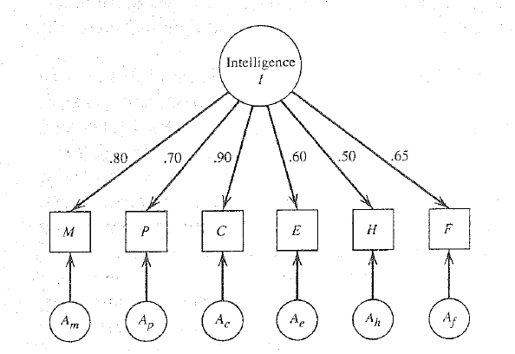
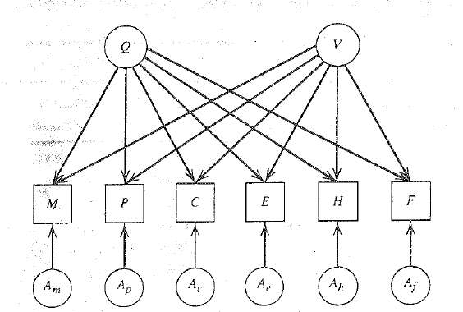
Factor Analysis – Visual representation
Common factor
unobserved
Common factors,
Q & V affecting scores
in subjects
Indicator
or Observed
Indicator
or Observed
Specific factor
unobserved
Specific factor
unobserved

Slide 8
Factor Analysis – Challenges
Factor Indeterminacy
Two different factor solutions provide the same communality and specific variance. The solutions also produce the same correlation matrix. This is factor indeterminacy due to factor rotation problem
Fix: Select a solution which provides the “best” theoretical justification or intuitive explanation of factors or suited to the practical problem
Factor indeterminacy also arises due to estimation of commonalty (or lack of it), i.e., circular argument. For example you need an estimate of communality (variance due to common factor) to estimate structural loading (correlation between indicator and factor). But you need to estimate structural loading first to estimate communality!
Fix: impose restrictions, for example, variance of specific factor is 1, i.e., var (w_{subject})=1

Slide 9
Factor Analysis – Challenges
Two factor solutions
Solution-1: m=0.68 q - 0.48 v + a_{m} p=0.74 q+ 0.36 v + a_{n}
Solution-2: m=0.80 q + 0.20 v + a_{m} p=0.20 q + 0.80 v + a_{n}
Total communality of m (variance due to common factors)
Solution-1= 0.68 x 0.68 + 0.48 x 0.48 = 0.4624 + 0.2304 = 0.69
Solution-2= 0.80 x 0.80 + 0.20 x 0.20 = 0.64 +0.04 = 0.68
Unique variance of m
Solution-1 = 1-0.69= 0.31
Solution-2 = 1-0.68= 0.32
Correlation between(m,p)
Solution-1 = 0.68 x 0.74 - 0.48 x 0.36 = 0.5032 - 0.1728 = 0.33
Solution-2= 0.80 x 0.20 + 0.20 x 0.80 = 0.16 +0.16 = 0.32

Slide 10
Factor Analysis and other techniques
The expression of a factor equation appears similar to that of a linear regression, e.g., g_{m}=0.75 I + w_{m}
Is factor analysis a special form a linear regression? Or are there significant differences between the two techniques?
Clustering: a large number of observations assigned to a few groups
Factor: a large number of variables reduced to a few factors
So what are the differences between the two techniques?

Slide 11
Recommended Readings
What is factor analysis and how does it simplify research findings? Retrieved from https://www.qualtrics.com/experience-management/research/factor-analysis/
A handout on Factor Analysis (U of T). Retrieved from http://www.utstat.toronto.edu/~brunner/oldclass/431s11/handouts/FactorAnalysis1.pdf

Slide 12
Next Session

